Slide 1
switching devices
Name: Tirth parmar
Company: Eco paradigm
Date: 01-02-2024

Slide 2
Switching devices
Relay
Transistor
Vacuum tubes
Optocoupler
Contactor Devices
MCB
Relay vs Transistor vs Vacuum tube vs Optocoupler vs Contactor vs MCB

Slide 3
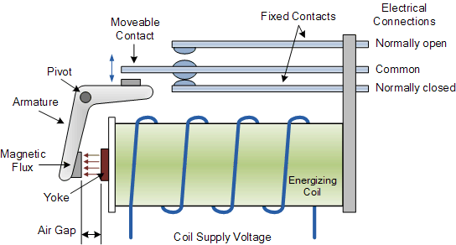
Relay
Introduction
Description
How to work??
Applications

Slide 4
Introduction
Relay is an electromechanical switching device most widely used in the automotive and telecommunication industries.
Electrical relays are crucial because they enable the control of high-current loads using a small amount of electrical current.
It generally consists of electromagnets that control the circuits electromechanically to make or break the load circuit.

Slide 5
Description
Armature– is a basic metal piece that is balanced on a pivot or a stand. It is considered the moving ‘arm’ of the relay. It makes or breaks the connection with the contacts connected to it.
Spring– is connected to one end of the armature and pushes the armature back into place if no current is passing through.
Electromagnet– is a metal wire wrapped around a metal core. The wire does not have magnetic property but can be converted into a magnet with the help of an electrical signal.
Yoke– is a small metal piece of a core which attracts and holds the armature when the coil is energized.
Contacts– conductive material that exists within the device whose physical contact opens or closes a circuit

Slide 6
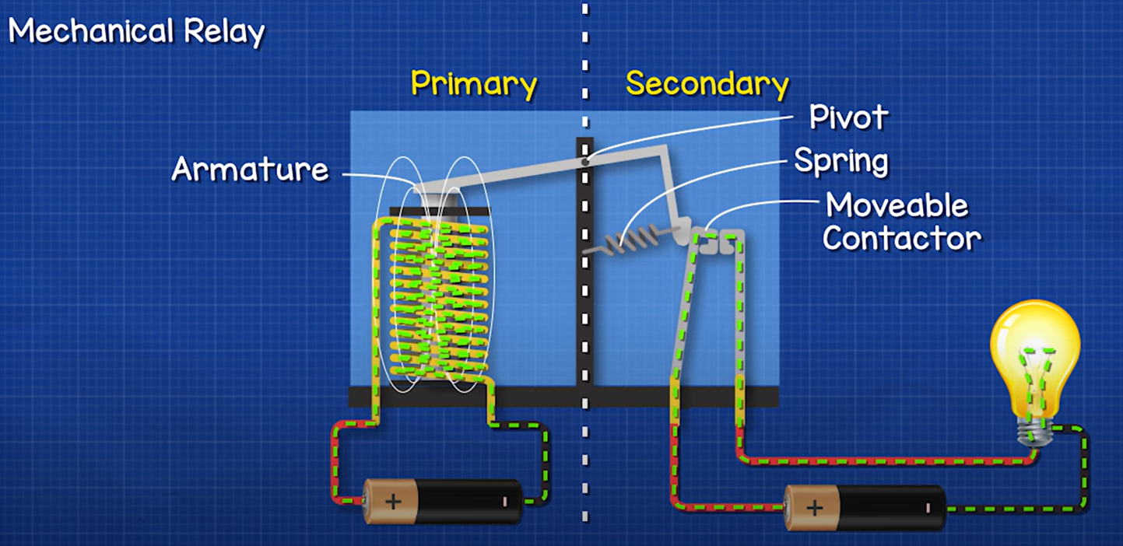
How to work??

Slide 7
The relay operating principle is, when a Voltage is applied to the electromagnetic coil, it magnetizes the iron core and generates the magnetic field which attracts the armature towards it. This makes the contact to close (closing the load circuit) or open in case if it is normally closed relay.
When the voltage is removed, the spring will push the contacts away, which breaks the load circuit.
When the switch is closed, the current starts flowing through the coil, and the magnetic field is generated in the coil which attracts the movable armature which will close the normally closed terminal. Hence, the lamp turns ON. So, we can control a high-power circuit through a low power signal using a relay.

Slide 8
Applications
For home appliances such as refrigerators, washing machines
For packing machinery, vending machines
Used in Aerospace, Defense, and automotive industries
Used in the traffic signal controllers, temperature controllers, heaters

Slide 9
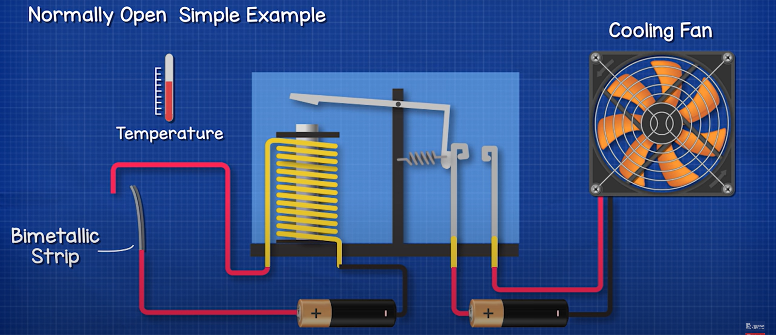

Slide 10
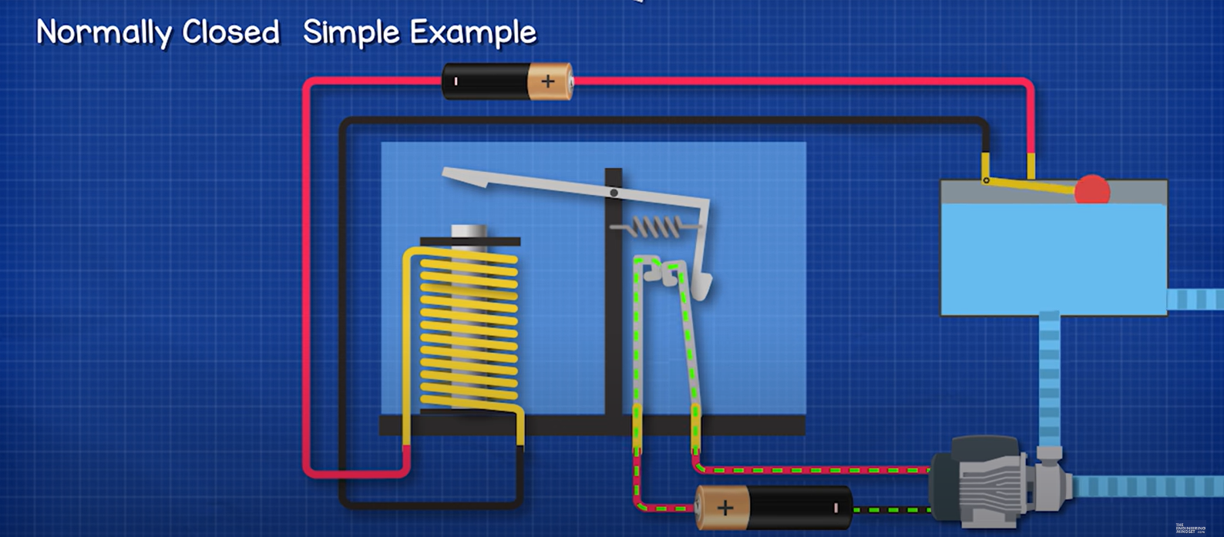

Slide 11
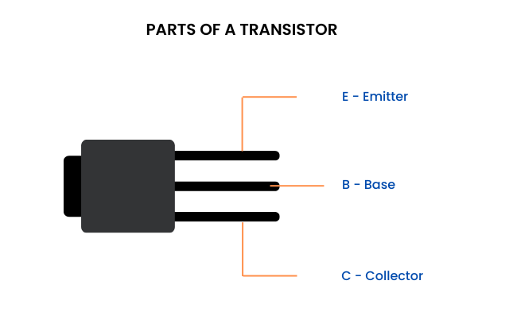
Transistor
Introduction
Description
How to work??
Applications

Slide 12
Introduction
A transistor is a type of semiconductor device that can be used to conduct and insulate electric current or voltage.
A transistor basically acts as a switch and an amplifier.
In simple words, we can say that a transistor is a miniature device that is used to control or regulate the flow of electronic signals.

Slide 13
description
Here, we take the BJT Transistor
Furthermore, there are two types of BJT, and they include:
P-N-P Transistor: It is a type of BJT where one n-type material is introduced or placed between two p-type materials. In such a configuration, the device will control the flow of current. PNP transistor consists of 2 crystal diodes which are connected in series. The right side and left side of the diodes are known as the collector-base diode and emitter-base diode, respectively.
N-P-N Transistor: In this transistor, we will find one p-type material that is present between two n-type materials. N-P-N transistor is basically used to amplify weak signals to strong signals. In an NPN transistor, the electrons move from the emitter to the collector region, resulting in the formation of current in the transistor. This transistor is widely used in the circuit.

Slide 14
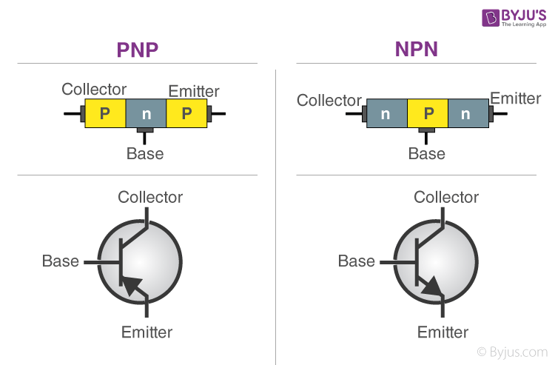

Slide 15
How to work??
The emitter of the NPN device is made of n-type material; hence, the majority of carriers are electrons. When the base-emitter junction is forward-biased, the electrons will move from the n-type region towards the p-type region, and the minority carrier holes move towards the n-type region.
When they meet each other, they will combine, enabling a current to flow across the junction. When the junction is reverse-biased, the holes and electrons move away from the junction, and now, the depletion region forms between the two areas and no current will flow through it.

Slide 16
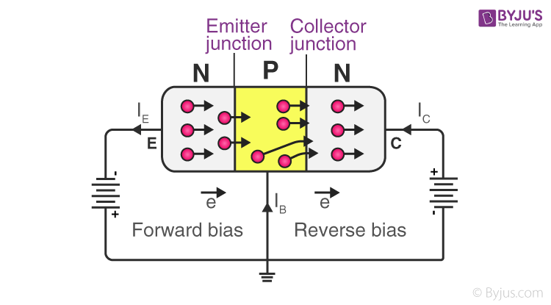

Slide 17
When a current flows between the base and emitter, the electrons will leave the emitter and flow into the base. Normally, the electrons will combine when they reach the depletion region.

Slide 18
Applications
Cameras
Calculators
Watches/Mobile phones/laptop/desktop
Highly suitable for low power applications

Slide 19
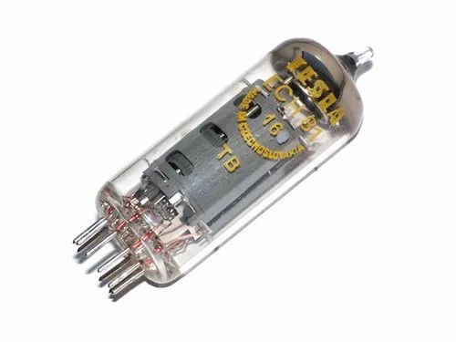
Vacuum tube
Introduction
Types and Working
Applications

Slide 20
Introduction
The vacuum is device that contains electrodes to control electron flow.
The vacuum tube produces electrons and an anode as it was made of a cathode, and the anode collects the electrons called a diode.
In early computers, it was also used as a switch or an amplifier, and it is also known as a valve or an electron tube.

Slide 21
Types and working
1) Diode Vacuum Tubes: The diode is the simplest form of the vacuum tube, which contains two terminals: an anode and a cathode. When the cathode is sufficiently heated, its electrons transfer from the surface due to the thermionic effect. If the cathode contains a higher electric potential and is applied to the anode, the cathode emits negatively charged electrons that are attracted to the anode. Then, the electric currents, via the convection, go in the direction of positive charges.

Slide 22
2) Triode Vacuum Tubes: It is another type of vacuum tube where the electric currents flow from the high potential V+. However, a valve is still needed that allows controlling this flow. In a triode, more like a third terminal, a grid is needed that is placed between the cathode and the anode.
As compared to the cathode, when the electric potential of the grid is lower, the cathode emits electrons that are repelled and help to find difficulties to reach the anode and movement of electrons between the terminals. If the grid is negative enough, its current gets blocked.

Slide 23
3) Tetrode Vacuum Tubes: The primary intention of the creation of the triode was related to the introduction of the tetrode vacuum tubes. Between the anode and the grid, the tetrode contains a fourth electrode called as the screen. The main objective of this advance component is to short the capacitance produced by the anode and the grid. The grid and the anode both work like a small-sized capacitor in a triode as they are located very close to one other, which may lead to instability and oscillations. While comparing with the cathode, if the screen consists of higher voltage but has lower voltage as compared to the anode, it reduces the inherent capacitance of the grid and the anode through working as an electrostatic screen between both (grid and anode).

Slide 24
pros & cons
PROS :
One of the best advantages of a vacuum tube is that it can be replaced easily.
Vacuum tubes have the ability to function at high temperatures without getting any defects.
They provide better sound quality.

Slide 25
CONS :
The size is one of the biggest disadvantages
They produce much heat and needed high energy to operate them.
They are more costly and consume more power.
As compared to transistors, vacuum tubes occupy more space.
The failure rate of vacuum tubes is high.

Slide 26
Appications
Televisions
Sound recording
Industrial automation reproduction
Radar equipment
Radios

Slide 27
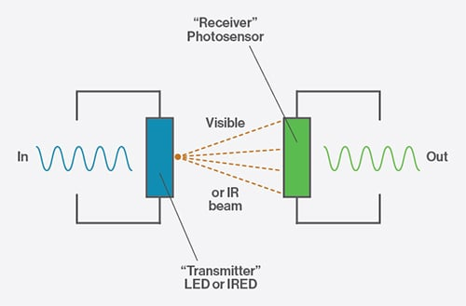
Optocoupler
Introduction
How to work??
Applications

Slide 28
Introduction
This device allows you to transmit an electrical signal between two isolated circuits with two parts.
An LED that emits infrared light and a photosensitive device which detects light from the LED.

Slide 29
How to work??
A current is first applied to the Optocoupler, which makes the infrared LED emit a light that’s proportional to the current. When the light hits the photosensitive device, it switches on and starts to conduct a current as any ordinary transistor might.

Slide 30
Benefits and applications
Benefits:
Remove electrical noise from signals
Isolate low-voltage devices from high-voltage circuits
Applications:
DC and AC power control
PC communications
power supply regulation

Slide 31
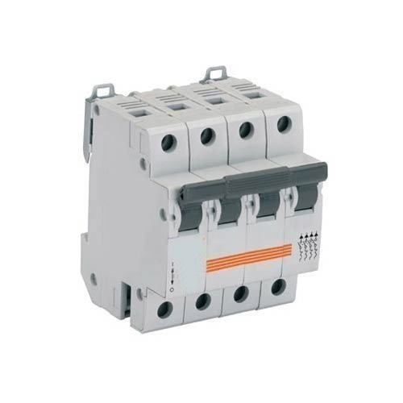
MCB
Introduction
How it works??
Appications

Slide 32
Introduction
MCB is an automatic switch that opens when excessive current flows through the circuit. It can be reclosed without any manual replacement.
Miniature Circuit Breaker is a safety accessory with an electro-mechanical mechanism of action.
The switches in the MCB automatically shut down and the fault of the device can be easily detected.

Slide 33
How its work??
When the current overflow occurs through MCB – Miniature Circuit Breaker, the bimetallic strip gets heated and deflects by bending. The deflection of the bi-metallic strip releases a latch. The latch causes the MCB to turn off by stopping the current flow in the circuit. This process helps safeguard the appliances or devices from the hazards of overload or overcurrent. To restart the current flow, MCB must be turned ON manually.

Slide 34
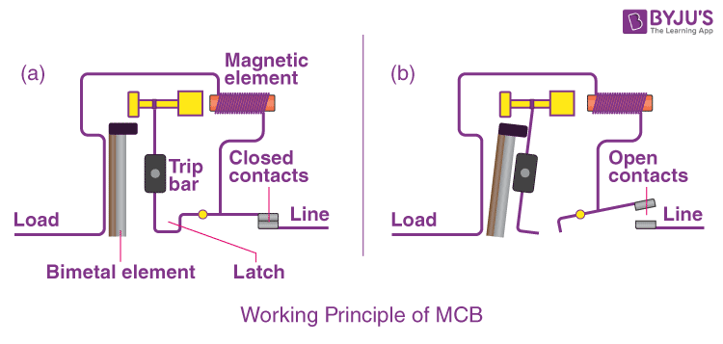

Slide 35
Applications
Industrial or domestic purposes
Lights
Heaters
Fan

Slide 36
Contactor
Introduction
How to work??
Applications

Slide 37
Introduction
A contactor is an electrical device that is widely used for switching circuits on and off.
Contactors are principally designed for use in applications where a large amount of current needs to be switched.

Slide 38
How to works??
The coil, or electromagnet, is the key component of a contactor. Depending on how the device is set up, it will perform a specific action on the switch contacts (opening or closing them) when it receives power
The contacts are the components of the device that carry power across the circuit being switched. There are various types of contacts found in most contactors, including springs and power contacts. Each type performs a specific function in transferring current and voltage
The contactor enclosure is another important part of the device. This is the housing that surrounds the coil and contacts, helping to insulate the contactor’s key components. The enclosure protects users against accidentally touching any conductive parts of the switch, as well as offering robust protection against risks such as overheating, explosion, and environmental hazards like dirt and moisture.

Slide 39
Applications
Controlling electric motors
Cooling fans
In water pumps
lighting

Slide 40
Relay vs Transistor vs Vacuum tube vs Optocoupler vs Contactor vs MCB
Parameters | Relay | Transistor | Vacuum tube | Optocoupler | MCB | Contactor
Speed | Relatively slower response time compared to solid-state devices. | Fast response time, suitable for high-frequency applications. | Slower compared to transistors. | Response time depends on the optical properties and construction. | Very fast response to overcurrent situations. | Slower compared to solid-state switches.
Size | Moderate to large size, depending on type and rating | Small to moderate size specially with modern semiconductor technology | Historically large, modern variants can be smaller. | Compact size. | Compact size, suitable for installation in electrical panels | Moderate to large size.

Slide 41
Reliability | Mechanical parts can wear out over time. | Solid-state reliability, sensitive to voltage and temperature. | Limited lifespan, susceptible to failure due to vacuum leaks or filament burnout. | Generally reliable but can degrade over time. | Reliable operation with proper maintenance. | Relatively reliable but subject to wear and tear.
Cost | Moderate cost. | Relatively inexpensive, especially with modern manufacturing techniques. | Historically expensive, now less common and more costly compared to solid-state devices. | Moderate cost. | Moderate cost, widely available. | Moderate to high cost, depending on size and capacity.

Slide 42
Thank you

